Slide 1


Pointers
Fundamental Computer Programming C++
Dr. Ihsan Ullah
ihsan@saturn.yzu.edu.tw
Office: 60913

Slide 2

Overview of Pointers
A Pointer in C++ is variable whose value is a memory address.
With pointers many memory locations can be referenced.
Some data structures use pointers (e.g. linked list, tree).
The * and & operators
- & operator is the address operator
- * operator is the dereferencing operator. It is used in
pointers declaration

Slide 3
Why use pointers?
Efficient memory management
Passing arguments by reference
Dynamic memory allocation
Accessing and manipulating arrays

Slide 4
Sizes of pointers
All pointers have the same size.
In a 32-bit computer, a pointer is allocated 4 bytes.
In a 64-bit computer, a pointer is allocated 8 bytes.
int* p1 = 0;
cout << sizeof(p1) << endl; // 8 double* p2 = 0;
cout << sizeof(p2) << endl; // 8
The length of pointers decides the maximum size of the memory space.

Slide 5
Sizes of pointers
#include <iostream>
using namespace std;
int main() {
int* p1 = 0;
cout << "Size of p1: " << sizeof(p1) << " bytes" << endl; // Size of p1: 8 bytes
double* p2 = 0;
cout << "Size of p2: " << sizeof(p2) << " bytes" << endl; // Size of p2: 8 bytes
return 0;
}

Slide 6
Pointer assignment
We use the address-of operator & to obtain a variable’s address:
pointer name = &variable name
The address-of operator & returns the (beginning) address of a variable.
Example:
– ptr points to a, i.e., ptr
stores the address of a.
int a = 5; int* ptr = &a;
When assigning an address, the two types must match.
int a = 5;
double* ptr = &a; // error!

Slide 7
Address operators
var1
var2
3
24
#include <iostream>
using namespace std;
int main()
{
// declare variables
int var1 = 3;
int var2 = 24;
int var3 = 17;
cout << "Address of var1: "<< &var1 << endl;
cout << "Address of var2: " << &var2 << endl;
cout << "Address of var3: " << &var3 << endl;
}
0x7fff5fbff8ac
0x7fff5fbff8a8
var3
17
0x7fff5fbff8a4
Output
Address of var1: 0x7fff5fbff8ac
Address of var2: 0x7fff5fbff8a8
Address of var3: 0x7fff5fbff8a4

Slide 8
Address operators
There are two address operators.
&: The address-of operator. It returns a variable’s address.
*: The dereference operator. It returns the pointed variable (not the value!).
For int a = 5:
a equals 5.
&a returns an address (e.g., 0x22ff78).
For int* ptrA = &a:
ptrA stores an address (e.g., 0x22ff78).
&ptrA returns the pointer’s address (e.g., 0x21aa74). This has nothing to do with the pointed variable a.
*ptrA returns a, the variable pointed by the pointer.

Slide 9
Pointer assignment
datatype *variable_name;
int *x; // a pointer to integer
double *x; // a pointer to double
float *x; // a pointer to float
char *ch // a pointer to a character
Bool *bool // a pointer to Boolean

Slide 10
Variables in memory
#include <iostream>
using namespace std;
int main() {
int a = 10;
int* p1 = &a;
cout << "value of a = " << a << endl; // value of a = 10
cout << "value of p1 = " << p1 << endl; // value of p1 = <address of a>
cout << "address of a = " << &a << endl; // address of a = <address of a>
cout << "address of p1 = " << &p1 << endl; // address of p1 = <address of p1>
cout << "value of the variable pointed by p1 = " << *p1 << endl; // value of the variable pointed by p1 = 10
return 0;
}

Slide 11
NULL Pointer
datatype *variable_name = NULL; // (“null” is wrong)
#include <iostream>
using namespace std;
int main() {
int *ip = NULL;
int *ip = 0; // also correct
cout << "Value of ip is: " << ip;
return 0;
}

Slide 12
Pointers and Arrays
#include <iostream>
using namespace std;
int main() {
int arr[] = {10, 20, 30};
int* ptr = arr;
// Output the first element of the array using array notation and pointer dereferencing
cout << arr[0] << "\n"; // Outputs 10
cout << *(ptr + 0) << "\n"; // Outputs 10
return 0;
}
#include <iostream>
using namespace std;
int main()
{
int arr[3] = {10, 20, 30};
int* ptr = arr;
for (int i = 0; i < 3; i++)
{
cout << *(ptr + i) << endl;
}
return 0;
}

Slide 13
Pointers with Functions
#include <iostream>
using namespace std;
void increment(int* p)
{
(*p)++;
}
int main() {
int val = 5;
cout << "Initial value of val: " << val << endl;
increment(&val);
cout << "Value of val after increment: " << val << endl;
return 0;
}

Slide 14
When we use * in declaring a pointer, that * is not a dereference operator.
– It is just a special syntax for declaring a pointer variable.
I prefer to view atype, which represents an “integer pointer”.
Therefore, I prefer “int* p” to “int *p”.
Be careful:
int *p, *q; // two pointers
int* p, *q; // two pointers
int* p, * q; // two pointers

Slide 15
Pass by values and References
Understand how arguments are passed to functions in C++
Call by Value: A copy of the actual parameter is passed.
Call by Reference: The actual parameter itself is passed, allowing modifications.
var1
3
0x7fff5fbff8ac

Slide 16
Call by Value Overview
Passing a copy of the value to the function. Changes made in the function do not affect the original variable.
#include <iostream>
using namespace std;
void modifyValue(int x) {
cout << "Value after call by value: " << x << endl; //
x = 20; // Only modifies the local copy
}
int main() {
int num = 10;
modifyValue(num);
cout << "Value after call by value: " << num << endl; // Outputs 10
return 0;
}

Slide 17
Call by Reference Overview
Passing the actual variable (memory reference) to the function. Changes made in the function affect the original variable.
#include <iostream>
using namespace std;
void modifyValue(int &x) {
x = 20; // Modifies the original variable
}
int main() {
int num = 10;
modifyValue(num);
cout << "Value after call by reference: " << num << endl; // Outputs 20
return 0;
}

Slide 18
Using Pointers in Call by Reference
Achieving call by reference by passing pointers
Pass a pointer to the function and dereference it to modify the value.
#include <iostream>
using namespace std;
void modifyValue(int* ptr) {
*ptr = 30; // Modifies the original variable through pointer dereferencing
}
int main() {
int num = 10;
modifyValue(&num); // Pass the address of num
cout << "Value after call by reference (pointer): " << num << endl; // Outputs 30
return 0;
}

Slide 19
Using Pointers in Call by Reference
Achieving call by reference by passing pointers
Pass a pointer to the function and dereference it to modify the value.
#include <iostream>
using namespace std;
void modifyValue(int* ptr) {
*ptr = 30; // Modifies the original variable through pointer dereferencing
}
int main() {
int num = 10;
modifyValue(&num); // Pass the address of num
cout << "Value after call by reference (pointer): " << num << endl; // Outputs 30
return 0;
}

Slide 20
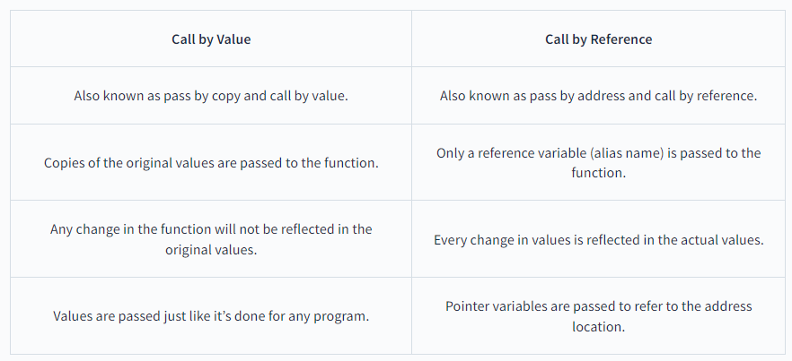
Difference Between Call by Value and Call by Reference in C++

Slide 21
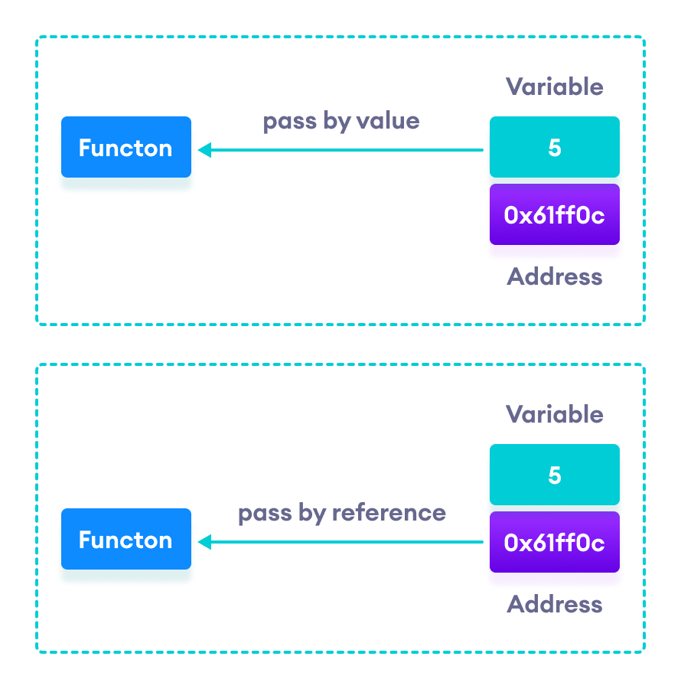
Pass by values and References

Slide 22
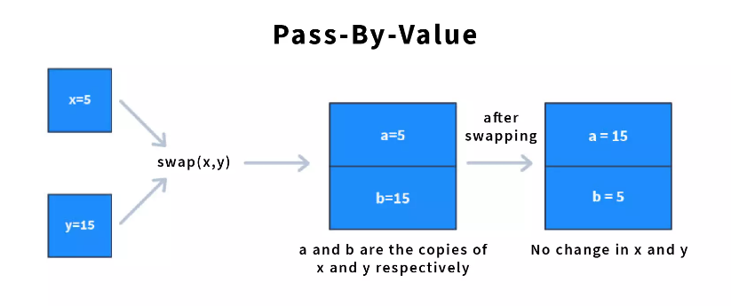
Pass-By-Value
#include <iostream>
using namespace std;
void swapByValue(int a, int b) {
int temp = a;
a = b;
b = temp;
cout << "Inside swapByValue: a = " << a << ", b = " << b << endl;
}
int main() {
int a = 5, b = 15;
cout << "Before swapByValue: a = " << a << ", b = " << b << endl;
swapByValue(a, b);
cout << "After swapByValue: a = " << a << ", b = " << b << endl;
return 0;
}

Slide 23
Pass-By-Value
#include <iostream>
using namespace std;
void increment(int x) {
x++; // Increment the copy
cout << "Inside function: " << x << endl;
}
int main() {
int num = 5;
increment(num);
cout << "Outside function: " << num << endl;
return 0;
}
Inside function: 6
Outside function: 5

Slide 24
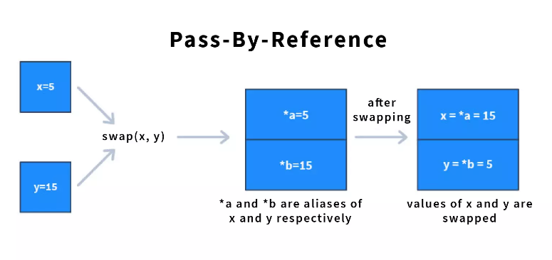
Pass-By-Reference
#include <iostream>
using namespace std;
void swap(int &a, int &b) {
int temp = a;
a = b;
b = temp;
}
int main() {
int a = 5, b = 15;
cout << "Before swap: a = " << a << ", b = " << b << endl;
swap(a, b);
cout << "After swap: a = " << a << ", b = " << b << endl;
return 0;
}

Slide 25
Pass-By-Reference
#include <iostream>
using namespace std;
void increment(int &x) {
x++; // Increment the original value
cout << "Inside function: " << x << endl;
}
int main() {
int num = 5;
increment(num);
cout << "Outside function: " << num << endl;
return 0;
}
Inside function: 6
Outside function: 6

Slide 26
Pointer to object
A pointer to an object refers to a memory address of object in memory.
#include <iostream>
using namespace std;
class MyClass {
public:
void display()
{
cout << "Hello from MyClass!" << endl;
}
};
int main() {
MyClass obj;
MyClass *ptr = &obj;
ptr->display();
(&obj)->display(); //same
(*ptr).display(); //same
return 0;
}

Slide 27
Pointer to class
A pointer to an object refers to a memory address of class in memory.
#include <iostream>
using namespace std;
class Base {
public:
virtual void display() {
cout << "Hello from Base class!" << endl;
}
};
class Derived : public Base {
public:
void display() override {
cout << "Hello from Derived class!" << endl;
}
};
int main() {
Base* ptr;
Derived obj;
ptr = &obj;
ptr->display();
(&obj)->display();
(*ptr).display();
return 0;
}

Slide 28
Pointer to function
A pointer to an object refers to a memory address of function in memory.
#include <iostream>
using namespace std;
int add(int a, int b) {
return a + b;
}
int subtract(int a, int b) {
return a - b;
}
int main() {
int (*ptr)(int, int);
ptr = &add;
cout << "Addition: " << ptr(5, 3) << endl;
ptr = &subtract;
cout << "Subtraction: " << ptr(5, 3) << endl;
return 0;
}

